Slide 1

COMMAND LINE ARGUMENTS IN C
MASKEEN 24CSU254
RUPESH 24CSU259
TANISHQ 24CSU262
BUSHRA 24CSU265
ANSH 24CSU275

Slide 2
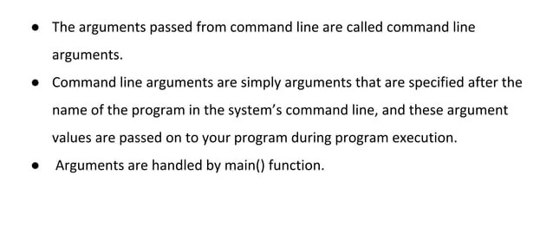
DEFINITION

Slide 3
WHEN DO WE NEED COMMAND LINE ARGUMENTS
They are used to control program from outside instead of hard coding those values inside the code.
With the help of command line arguments we can create our own commands.

Slide 4
COMPONENTS
Argc
(Argument count)
It stores the number of command line arguments passed by the user including the name of the program
The default value of argc is 1
So if we pass a value to the program, value of argc would be 2 (one for argument and for program name)
Argv
(argument vector)
It is an array of character pointers listing all the arguments.
If argc > 0 , the array elements from argv[0] to argv[argc-1] will contain pointer to strings.
Argv[0] is the name of the program, after that every element is that argument that we pass.

Slide 5
PROPERTIES
They are passed to main() function.
They are parameters/ arguments supplied to the program when it is invoked
It provides a simple accurate, keyboard based method for interacting with all types of computer programs.
Each string in argv is null terminated , making them compatible with standard c sting functions.

Slide 6
SYNTAX
int main(int argc, char *argv[])
{
// code
}

Slide 7
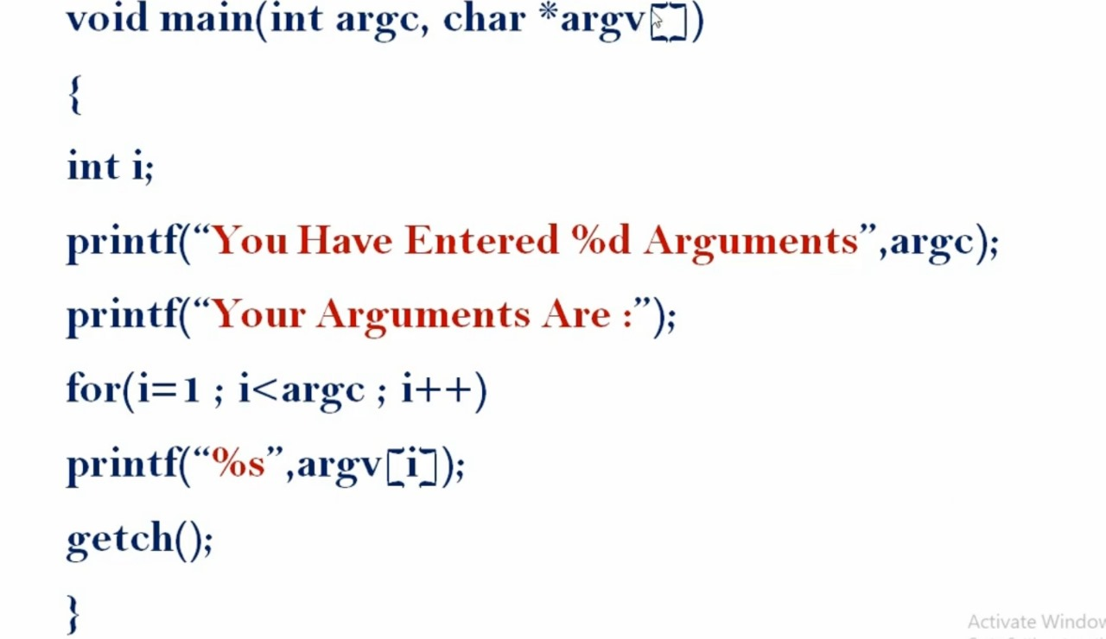
EXAMPLE

Slide 8
OUTPUT
// If the program is run with 3 arguments
You Have Entered 4 Arguments
Your Arguments Are : arg1 arg2 arg3

